Slide 1
Database Design
Databases Systems [BS-IV(cs/se)] [Fall 2022]
Most of the content was taken from slides of book “Database System Concepts, 7th Ed, Silberschatz, Korth and Sudarshan”

Slide 2
The Enhanced Entity-Relationship Model
Semantic concepts are incorporated into the original ER model and called the Enhanced Entity-Relationship (EER) model.
Examples of additional concept of EER model is called specialization / generalization.

Slide 3
Specialization / Generalization
Superclass
An entity type that includes one or more distinct subgroupings of its occurrences.
Subclass
A distinct subgrouping of occurrences of an entity type.

Slide 4
Specialization / Generalization
Superclass/subclass relationship is one-to-one (1:1).
Superclass may contain overlapping or distinct subclasses.
Not all members of a superclass need be a member of a subclass.

Slide 5
Specialization / Generalization
Attribute Inheritance
An entity in a subclass represents same ‘real world’ object as in superclass, and may possess subclass-specific attributes, as well as those associated with the superclass.

Slide 6
Specialization / Generalization
Specialization
Process of maximizing differences between members of an entity by identifying their distinguishing characteristics.
Generalization
Process of minimizing differences between entities by identifying their common characteristics.

Slide 7
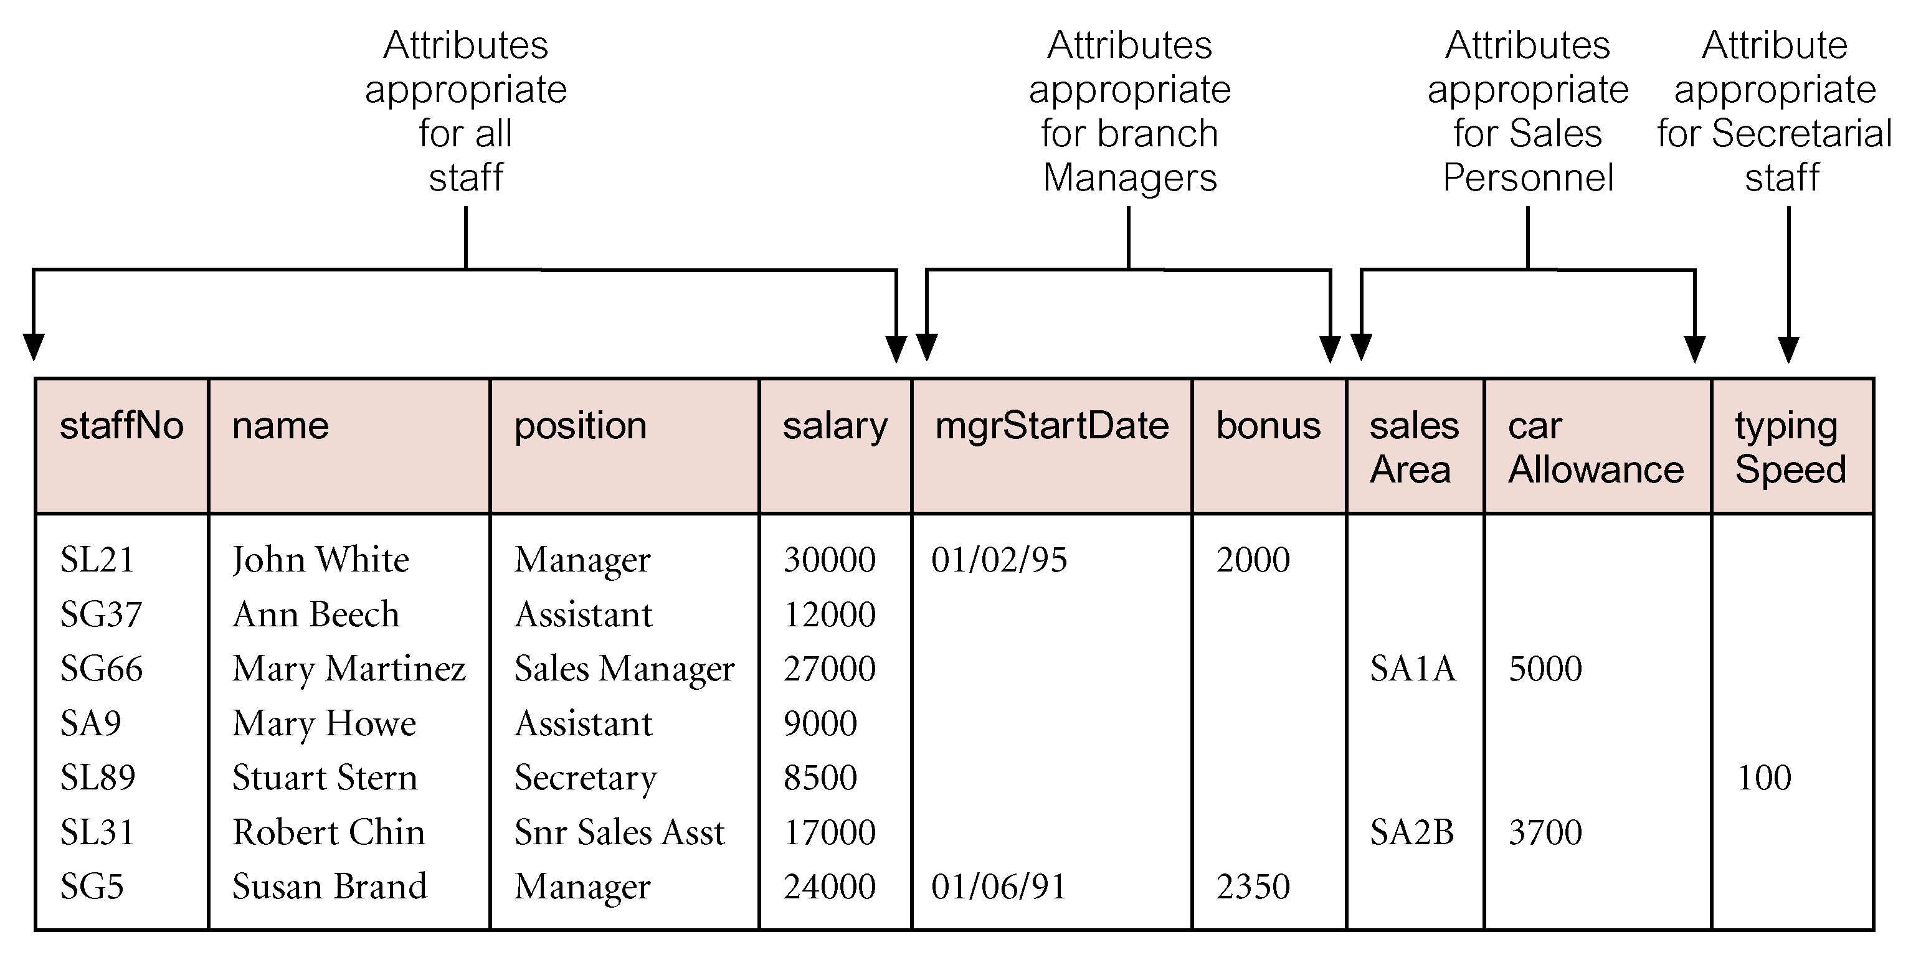
AllStaff relation holding details of all staff

Slide 8
staffNo
Name
Position
salary
Staff
isA
typingSpeed
mgrStartdate
bonus
Manager
Secretary
salesArea
carAllowance
SalesPersonnel

Slide 9
Constraints on Specialization / Generalization
Two constraints that may apply to a specialization/generalization:
Participation constraint
Determines whether every member in superclass must participate as a member of a subclass.
May be total or partial.
Disjoint constraint
Describes relationship between members of the subclasses and indicates whether member of a superclass can be a member of one, or more than one, subclass.
May be disjoint {OR} or overlap{AND}.

Slide 10
staffNo
Name
Position
salary
Staff
{OR, Total}
isA
isA
{AND, Partial}
mgrStartdate
bonus
typingSpeed
Secretary
Manager
SalesPersonnel
salesArea
carAllowance
hourlyRate
salaryScale
Allownce
Permanent
PartTime

Slide 11
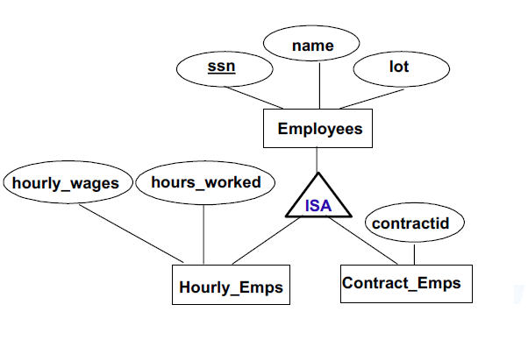

Slide 12
Translation to Relation Schemas

Slide 13
Derive relations for logical data model
(1) Strong entity types
For each strong entity in data model,
Create relation that includes all simple attributes of entity
For composite attributes, include only constituent simple attributes
(2) Weak entity types
For each weak entity in data model,
Create relation that includes all simple attributes of entity
Primary key of weak entity is partially or fully derived from each owner entity

Slide 14
Derive relations for logical data model
(3) One-to-many (1:*) binary relationship types
For each 1:* binary relationship,
Entity on ‘one side’ of relationship designated as parent entity
Entity on ‘many side’ designated as child entity
Represent relationship by posting copy of primary key attribute(s) of parent entity into relation representing child entity
Acts as foreign key
If relationship has attributes
Post attributes to child entity along with copy of parent entity primary key

Slide 15
Derive relations for logical data model
(4) One-to-one (1:1) binary relationship types
Cardinality cannot be used to identify parent and child entities
Participation constraints used
Options:
Represent relationship by combining entities involved into one relation
Create two relations and post copy of primary key from one relation to other
Consider the following:
(a) total participation on both sides of 1:1 relationship
(b) total participation on one side of 1:1 relationship
(c) partial participation on both sides of 1:1 relationship

Slide 16
Derive relations for logical data model
(a) Total participation on both sides of 1:1 relationship
Combine entities involved into 1 relation
Choose one primary key of original entities to be primary key of new relation
Other primary key (if one exists) used as alternate key
If relationship has attributes → include in merged relation
(b) Total participation on one side of a 1:1 relationship
Identify parent and child entities using participation constraints
Entity with partial participation in relationship designated as parent
Entity with total participation designated as child
Place copy of primary key of parent in relation representing child
If relationship has one or more attributes → post to child relation following primary key
Preference example

Slide 17
Derive relations for logical data model
(c) Partial participation on both sides of a 1:1 relationship
Designation of parent and child entities arbitrary unless more about relationship known
If one entity closer to being total → choose as child
‘Staff Uses Car’ Example

Slide 18
Derive relations for logical data model
(5) One-to-one (1:1) recursive relationships
Follow rules for participation for 1:1 relationship
Total participation on both sides
Represent recursive relationship as single relation with two copies of primary key
One copy => primary key; other copy => foreign key, should be renamed
Total participation on only one side
Options:
Create single relation with two copies of primary key
Create new relation to represent relationship
New relation would only have two attributes => both copies of primary key
Copy of primary keys act as foreign keys, should be renamed to indicate purpose
Partial participation on both sides
Create new relation as described above

Slide 19
Derive relations for logical data model
(7) Many-to-many (*:*) binary relationship types
Create relation to represent relationship and include any attributes that are part of relationship
Post copy of primary key attribute(s) of entities that participate in relationship into new relation - act as foreign keys
Foreign keys also form primary key of new relation
Possibly in combination with other attributes of relationship
See ‘Client Views PropertyForRent’ relationship

Slide 20
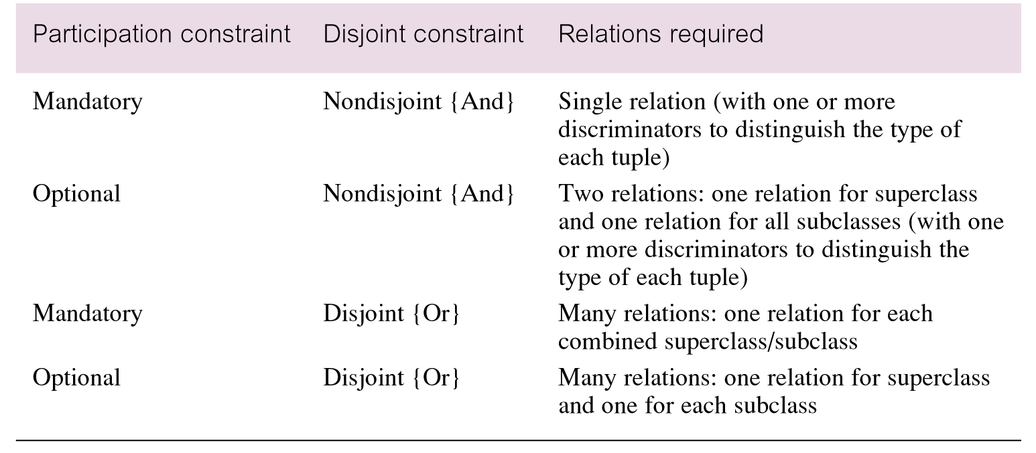
Guidelines for representation of superclass / subclass relationship

Slide 21
Representation of Entity Sets with Composite Attributes
Composite attributes are flattened out by creating a separate attribute for each component attribute
Example: given entity set instructor with composite attribute name with component attributes first_name and last_name the schema corresponding to the entity set has two attributes name_first_name and name_last_name
Prefix omitted if there is no ambiguity (name_first_name could be first_name)
Notes:
21

Slide 22
Representation of Entity Sets with Multivalued Attributes
A multivalued attribute M of an entity E is represented by a separate schema EM
Schema EM has attributes corresponding to the primary key of E and an attribute corresponding to multivalued attribute M
Example: Multivalued attribute phone_number of instructor is represented by a schema: inst_phone= ( ID, phone_number)
Each value of the multivalued attribute maps to a separate tuple of the relation on schema EM
For example, an instructor entity with primary key 22222 and phone numbers 456-7890 and 123-4567 maps to two tuples: (22222, 456-7890) and (22222, 123-4567)
Notes:
22

